Slide 1
Modernize identity management customer presentation
Title of presentation | Modernize identity management: Upgrade from AD FS
Presentation length | 30 minutes
Audience | Customers with Active Directory Federation Services (AD FS) deployed in their environment. Enterprises, SMC and Partners IT Decision Makers and IT Admins
Presenter | ATS, Cloud Endpoint TS, CSAM, Security CSA
Purpose | This deck demonstrates the value of migrating your app authentication and user authentication from Active Directory Federation Services (AD FS), to Azure Active Directory. It is designed for IT decision makers and provides a high-level presentation of the value of migrating from AD FS to Azure AD. It also provides the features and tools that can help organizations get started on migration from AD FS to Azure AD.
Tips for presenting | If you have limited time with the customer focus on showing the benefits gained when choosing Azure AD over AD FS (slide 7, 9-12) and the steps that customers can get started on their cloud migration journey (slide 14). Appendix section slides are L200 and L300 depth content to help customers understand the features and tools available in Azure AD to assist in making migration off AD FS easier.
Instructions | Please always make sure to download the latest version at aka.ms/adfstoaaddeck before presenting.
Additional resources | Build Zero Trust foundations Sales Play Identity and Access Management Customer Presentation Secure access to all apps with Azure AD Customer Presentation
Notes:
As digital transformations accelerate it inevitably makes sophisticated attacks and hidden vulnerabilities top of mind for organizations and individuals.
Zero Trust is the security framework that responds to the needs of individuals and organizations in this context.
Customers that are at an early stage of their journey should start by establishing a solid foundation for their Zero Trust security strategy.
Identity and Management are the two fundamental cornerstones.
Customers need to modernize and secure their identity platform, to have a seamless experience when accessing all their apps and data.
Customers also need to secure their endpoints as if a customer does one without the other, there will be gaps at a foundational level of their Zero Trust strategy.
Notes begin on slide 2

Slide 2
Modernize your identity management
Improve your security posture by upgrading from Active Directory Federation Services (AD FS) to Azure Active Directory
Notes:
My name is [name] and today I’d like to talk with you about modernizing your identity management by upgrading from AD FS to Azure Active Directory.

Slide 3


Today’s security challenges facing organizations
Average cost of a breach for organizations cost $4.72M
79%
of surveyed enterprises have experienced a cyber breach in the past year²
80%
of breaches involve the use of lost or stolen passwords
60%
fewer security incidents with public cloud service workloads than those in traditional data centers³
Source: ¹ Average cost of breach for organizations with 5,001-10,000 employees from Ponemon Institute; ² Forrester Study: The 2020 state of security operations (Commissioned by Paolo Alto Networks); ³ Gartner Report: Cloud Strategy Leadership
Dark Orange
Rich Black
R255 G147 B73 Hex #FF9349
Dark Yellow
Rich Black
R254 G240 B0 Hex #FEF000
Dark Green
Rich Black
R155 G240 B11 Hex #9BF00B
Dark Teal
Rich Black
R48 G229 B208 Hex #30E5D0
Dark Blue
Rich Black
R80 G230 B255 Hex #50E6FF
Dark Purple
Rich Black
R213 G157 B255 Hex #D59DFF
White
Rich Black
R216 G59 B1
Hex #D83B01
Rich Black
R255 G185 B0
Hex #FFB900
White
R16 G124 B16
Hex #107C10
White
Rich Black
R0 G133 B117
Hex #008575
White
Rich Black
R0 G120 B212
Hex #0078D4
White
Rich Black
R134 G97 B197
Hex #8661C5
Light Orange
White
R107 G41 B41 Hex #6B2929
Light Yellow
White
R106 G75 B22 Hex #6A4B16
Light Green White
R5 G75 B22 Hex #054B16
Light Teal
White
R39 G75 B71 Hex #274B47
Light Blue
White
R36 G58 B94 Hex #243A5E
Light Purple
White
R59 G46 B88 Hex #3B2E58
Notes:
The threats against data security are everywhere, with companies like Solarwinds, Nobelium, and Colonial Pipeline navigating through the aftermath of costly cyberattacks. In fact, 79% of enterprises have experienced a cyber breach in the last year; with an average cost of $4.72M per data breach³, and with a continuous increase in security threats, it is critical to approach data protection proactively.
80% of security breaches involve the use of lost or stolen passwords. The majority of organizations remain vulnerable to even the most common and preventable cybercrimes. This upward trend in security threats is influencing the investment decisions of IAM decisionmakers, driving the desire for a single identity management solution and encouraging a shift to a Zero Trust security framework.
According to Gartner, estimates show that public cloud service workloads will suffer at least 60% fewer security incidents than those in traditional data centers. This means that migrating to the cloud is actually more secure than your data remaining on-premises, and if you then implement a Zero Trust framework in the cloud, your organization is in a strong position to prevent cyberattacks before they begin.
(Gartner report: cloud_strategy_leadership.pdf (gartner.com))

Slide 4
Today’s security challenges are influencing IAM investment decisions
Top 5 IAM investments companies are planning for over the next 12 months
1
2
3
79%
of surveyed enterprises have experienced a cyber breach in the past year²
80%
of breaches involve the use of lost or stolen passwords
60%
fewer security incidents with public cloud service workloads than those in traditional data centers³
Looking to have one single identity management solution
Retiring old IAM solutions / upgrading
Optimizing the end user experience
Implementing Zero Trust
Multi-cloud Privileged Access Management
Source: Microsoft Commissioned IAM Audience Tracker Study 2021
Notes:
As shown, 30% of decisionmakers consider finding a single identity management solution their top investment priority. With this naturally comes the desire to retire old IAM solutions and upgrade, while optimizing the end-user experience; 27% of IAM decisionmakers consider these to be top investment priorities as well. Our changing world also requires a new approach to security that goes hand-in-hand with implementing a single identity management solution: enacting a Zero Trust security framework is another top-5 investment priority.

Slide 5
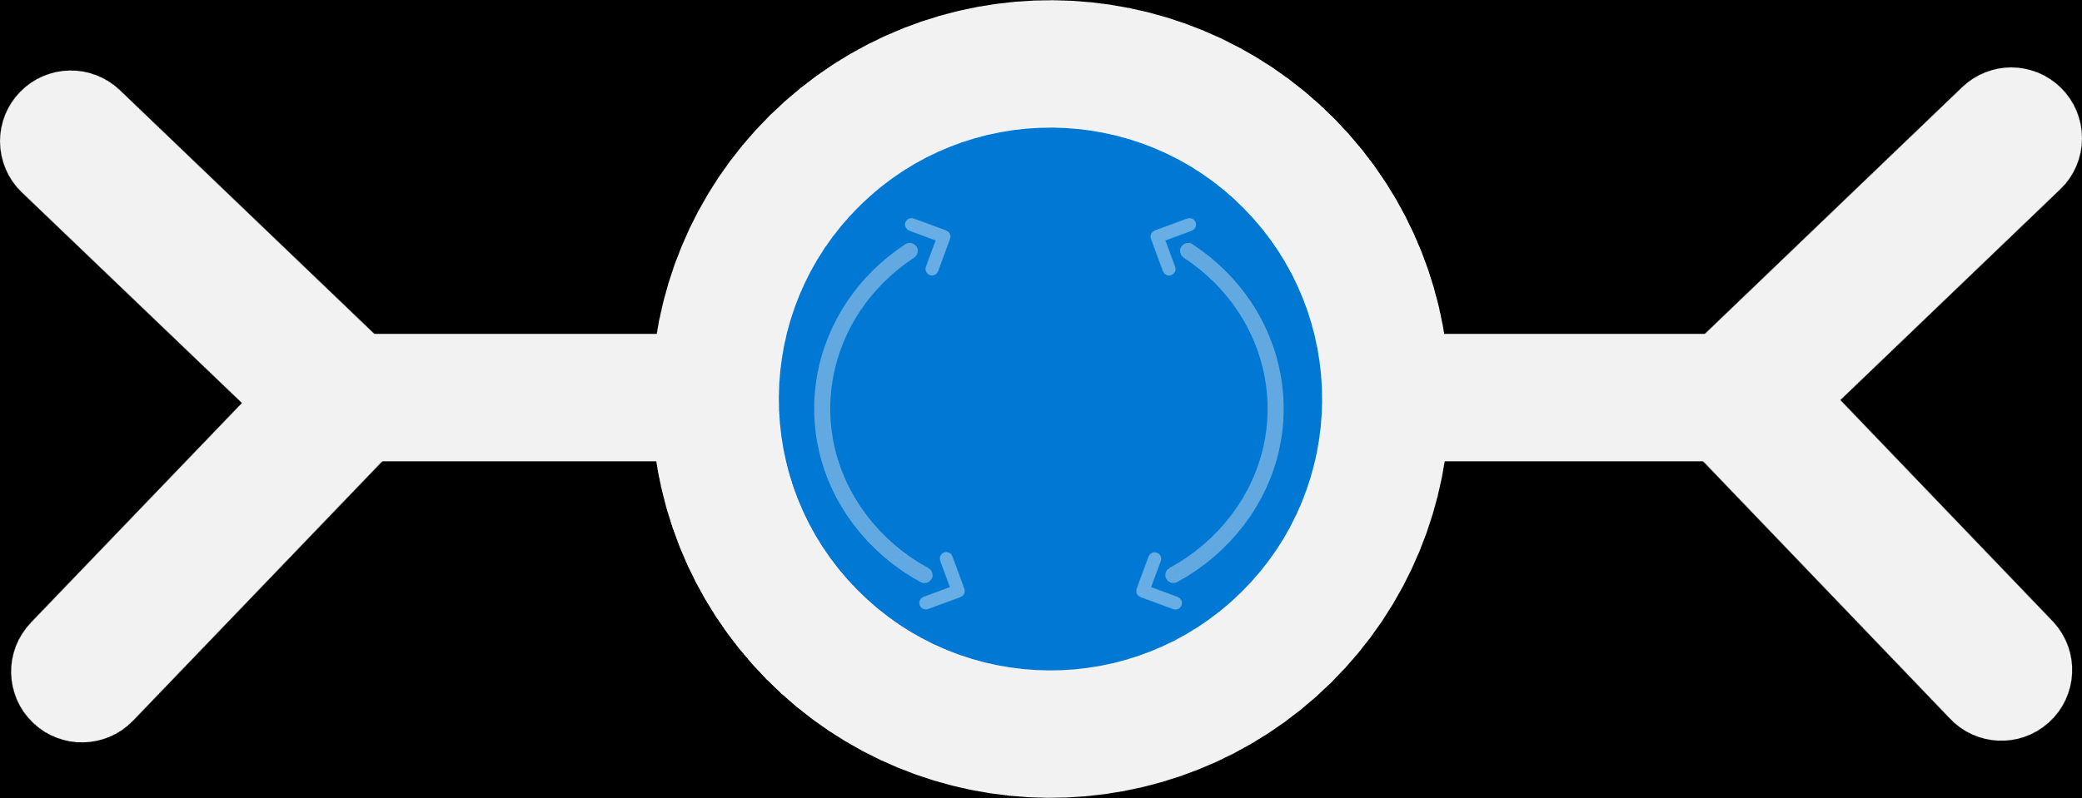
Secure your organization with Zero Trust
A modern security framework with identity as its foundation
Verify explicitly | Use least privilege access | Assume breach
Data
Context
Identities
Security enforcement policy
Apps
Endpoints
Infrastructure
Control
Network
Visibility | Analytics | Automation
Notes:
As one of the top five priorities for decisionmakers, 96% state that Zero Trust is critical to their organization’s success. So, let’s dive into what exactly a Zero Trust framework entails.
Zero Trust is a security framework that responds to the needs of individuals and organizations in this new reality. A Zero Trust approach considers three key principles: verify explicitly, use least privilege access and assume breach.
Verify explicitly means moving from assumption to explicit verification. Always authenticate and authorize based on all available data points, such as user identity, location, device health, application, and more.
Use least privilege access and adopt a policy-based access model. Limit user access to only what they need.
And finally, assume breach. Design with the assumption that every element of your system can be breached. Minimize the blast radius for breaches and employ a security strategy to prevent lateral movement.
A Zero Trust approach should extend throughout the entire digital estate—which includes identities, endpoints, apps, data, infrastructure, and networks—and serve as an integrated security philosophy and end to end strategy.

Slide 6


Your most strategic projects require modern identity management
Future-proof your business by upgrading from Active Directory Federation Services to Azure AD
Build a foundation to Zero Trust
Secure the hybrid workforce
Improve operational efficiency
Increase resiliency and adapt to change
Notes:
Zero Trust is the new framework we need to think about when it comes to security. Implementing your Zero Trust approach requires modernizing your identity management systems.
As we learned earlier, Zero Trust is now the top security priority: 96% of decisionmakers state that Zero Trust is critical to their organization's success. In order to successfully manage a hybrid workforce, you’ll need to build the foundation to Zero Trust with modern identity management. This transition will empower your organization to operate efficiently and increase IT productivity with unified identity management, while also increasing your organization’s resiliency.
Hand-in-hand with Zero Trust, identity modernization is now top of mind for all IAM decisionmakers, with 30% of IAM decisionmakers citing a singular identity management solution as their top investment priority. Modernizing your identity management systems not only enables strategic projects like widespread Zero Trust adoption, but it also unlocks a lot of other initiatives – such as adaptability and resiliency – and empowers you to increase your operational efficiency even while moving towards a hybrid workforce. In fact, the shift to hybrid work is driving the move towards broader adoption of Zero Trust, with 81% of organizations already beginning to move towards a hybrid workplace, and Zero Trust will be critical to help maintain security.
A common first step in deciding to modernize your identity management is to evaluate your existing systems, such as AD FS. Wouldn’t it be great to cut out any extra work, or extra hoops to jump through? By upgrading to Azure Active Directory, your organization can take advantage of a single identity management solution and an industry-leading security framework. You’ll enable everyone in your organization to complete their tasks securely and efficiently, from anywhere.

Slide 7

AD FS vs. Azure AD
Protect your organization with Azure AD, a complete identity and access management solution
AD FS
Azure AD
Complex to set up and maintain
Microsoft managed identity-as-a-service
Maintain multiple servers for high availability
99.99% service resiliency
Build and maintain app integrations
Pre-integrated applications
Coarse grained access controls
Granular adaptive access controls
Connect multiple IAM solutions together
Consolidated and complete IAM
Notes:
Based on the current identity landscape, it’s clear that the traditional approach to technology and identity does not work for our new reality. We can evaluate AD FS and compare your existing systems to Azure AD; as we can see, Azure AD truly is the key to modernizing your workforce and improving your security posture.
Today, our perimeter is everywhere: our move from on-premises corporate network to the cloud was already underway, but now it’s accelerated, along with a transition from on-prem apps and data to cloud resources such as SaaS apps. Employees are using a mix of devices to get work done, including corporate-provided devices, personal devices, and smartphones, meaning that your organization needs a new approach to endpoint technology, its security, and use in the workplace. Today, more than ever, everything is interconnected: from modern apps, to cloud resources, to new Internet of Things capabilities, it’s up to you to ensure that your organization can remain secure no matter where or how your employees are working.

Slide 8
Self-Service Management
Password Reset & Change
Group Management
Credential Registration
Credential Recovery
App Launching
Access Requests & Approvals
Profile Management
Authorization
Machine learning based risk scoring
Adaptive Access
OAuth Authorization management
OAuth Token issuance & revocation
Claims/Attribute mapping
Role based access control
Session lifetime management
Customer IAM
Social Identity Federation
Self-Service Registration
Custom End User Experiences
Customer Data Management
Consent Management
Administer Users & Partners
Privacy Management
Governance
Access certifications
Privileged Access/Just-In-Time
Entitlement management
Identity Lifecycle
Access Requests
Workflow
Automated User/Group provisioning
Policy management
Reporting, Auditing & Analytics
Data Access Policies
Authentication
User Authentication
Multi-factor authentication (MFA)
Single Sign on (SSO)
Federation
Passwordless Authentication
Passwordless FIDO2 Key Partners
Certificate/Smartcard based authentication Partners
Federated IdP Partners
Application access
Pre-integrated SSO and Provisioning
BYO SAML & OATH 2.0
Custom Provisioning (SCIM)
HR-driven provisioning partners
Web Access Manager
Hosted Directory Services
Secure Hybrid Access & VPN Partners
Windows VDI Integration
Azure AD
Your complete identity and access management solution with integrated security
Developer Support
API Management
API Security
Solution API’s
SDK’s
Externalized RBAC/PEP/PDP
Application Registration
Managing Cloud Infrastructure
Managed Identities
PaaS Identity management
IaaS/VM Identity Management
Administration
User Management
Group Management
Domain Management
Delegated Administration
Application Management
Password Management
Notes:
A survey we ran earlier this year found on average that some customers may have up to 9 identity solutions: for example, you might have a separate MFA solution, a separate SSO solution, a separate adaptive access solution, and perhaps even more. As you can imagine, having all these solutions from different vendors is not only complicated to manage, but also increases costs and potential for cybersecurity risks.
Your company may be using products that can do one or more of these things, but Azure AD has capabilities in all these areas.
You’re invested in Azure AD, so it makes sense to take advantage of the breadth of these capabilities built-in to Azure AD, rather than to pay for redundant, single-use tools. Azure AD is the right solution for you if you’re looking for industry-leading technology that empowers your entire organization to focus on strategic initiatives, enhance hybrid workforce productivity, and upgrade your data and device security from anywhere.

Slide 9



What Azure AD can do for your organization
Benefits your organization can realize when migrating from AD FS to Azure AD
Protect your data with industry-leading security
Increase productivity with seamless access
Improve IT efficiency and free up focus
Notes:
Moving from AD FS to Azure AD allows you to navigate the complex security landscape and the issues that come with this complexity. Microsoft defines the benefits of this migration with three core principles:
Protect your data: when you consolidate identity management and employ a Zero Trust security approach, you can reduce data breaches by 45%.
Increase organization productivity: with seamless access to apps and tools, Azure AD empowers your employees to manage their own identities and reduce password-reset calls by 75%.
Improve IT efficiency: consolidating identity management reduces IAM management effort by up to 50%, freeing your IT department to focus their energy on other, more critical tasks.
Without migrating to AD FS it’s much more difficult to achieve these things.

Slide 10
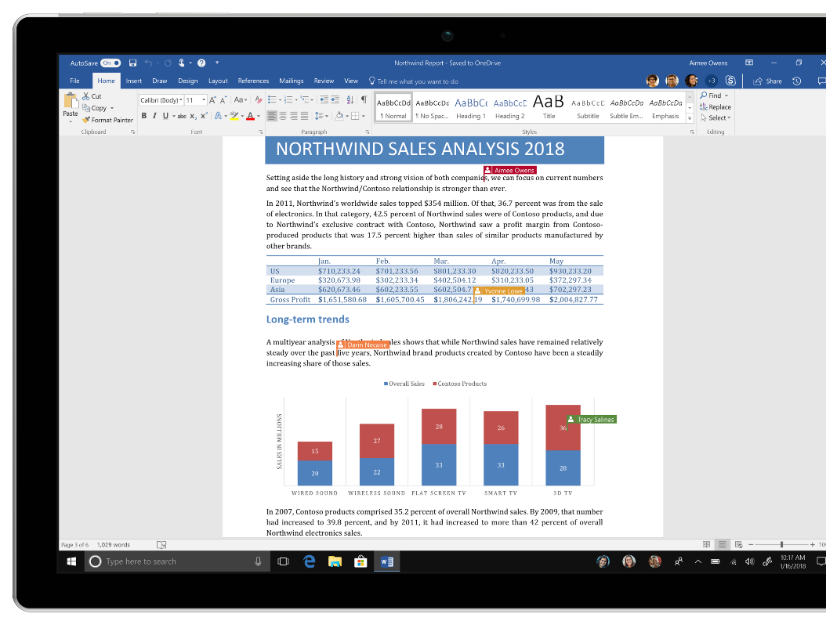
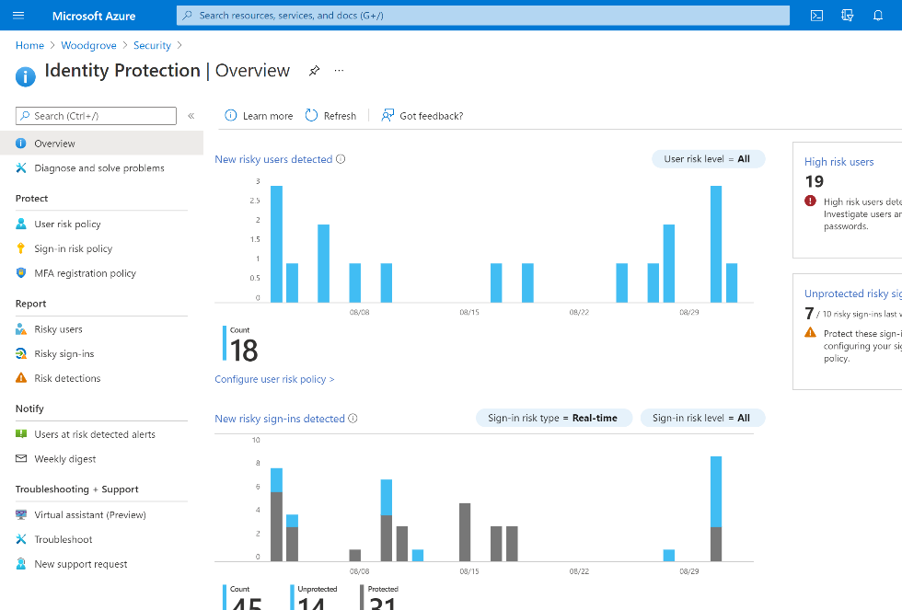
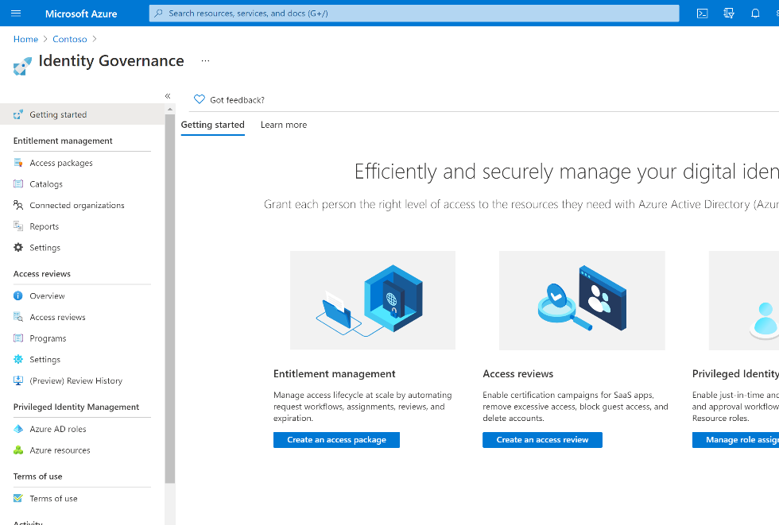
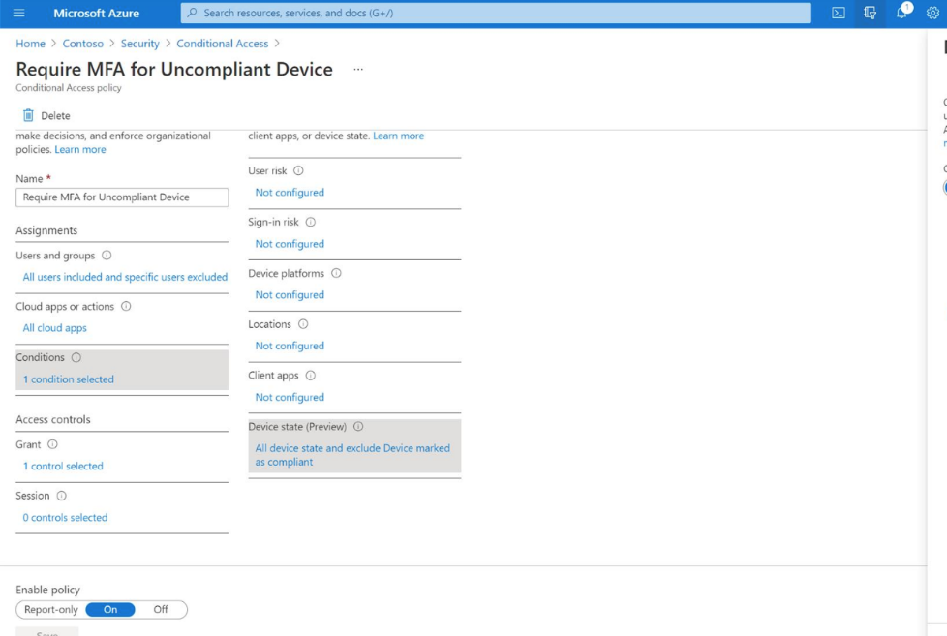
Protect your data with industry-leading security
Reduce data breaches by 45% by consolidating identity management
Secure access to resources Protect access to resources using strong authentication and intelligent adaptive access.
Protect against identity compromise Intelligently detect and respond to compromised accounts using cloud-based AI and automation.
Govern and manage access rights Protect, monitor, and audit access to critical assets and ensure only authorized users have access.
Notes:
Azure AD provides industry-leading security to safeguard your organization.
Protect access to resources and data using strengthened authentication measures and risk-based adaptive access policies without compromising user experience; intelligently detect and respond to compromised accounts using cloud-based AI and automation capabilities; and, control, monitor and audit access to company resources with automated identity governance to ensure only authorized users have access.
If you choose to implement a Zero Trust security approach as well, Azure AD empowers your organization to truly take charge of its data and device security. With the principles “verify explicitly, use least privilege access and assume breach” working in tandem with AAD’s already-embedded security functionality, your organization will be positioned to proactively avoid cyberthreats.

Slide 11
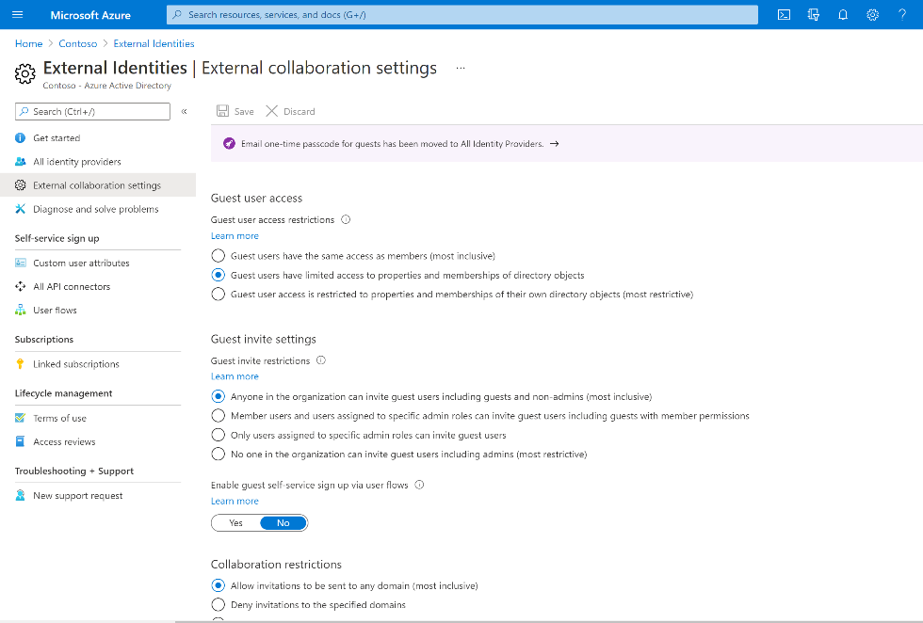
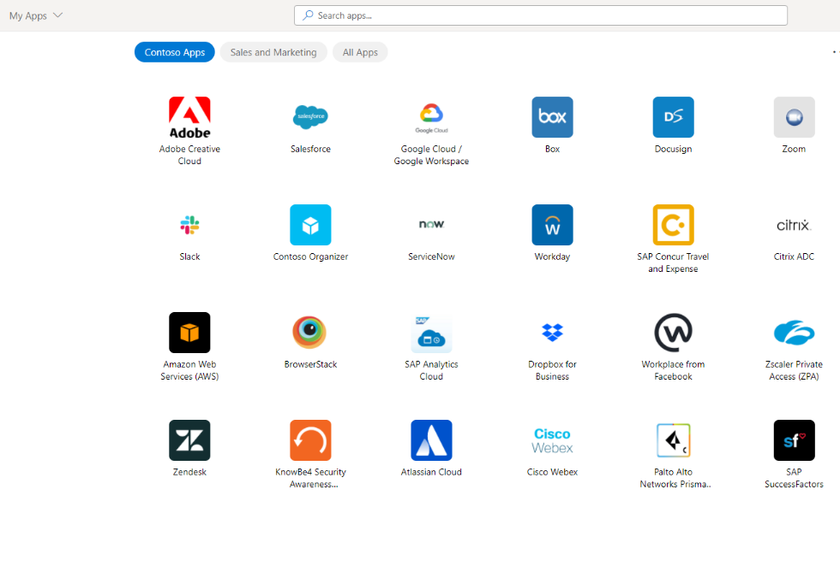
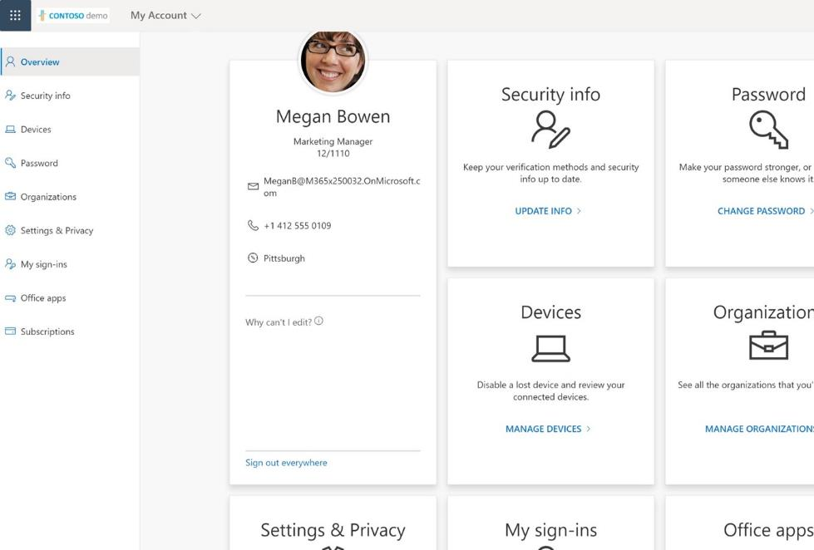
Increase productivity with seamless access
Decrease password reset calls by 75% by empowering employees to manage their own identity
Streamline access Enable seamless, secure access to your cloud, premises and custom apps with single sign-on.
Empower with self-service Grant your workforce self-service identity experiences such as resetting passwords.
Collaborate seamlessly with partners Invite B2B partners to collaborate and securely share your organization’s apps and resources
Notes:
Azure AD allows your organization to enable seamless, secure access to your cloud, premises and custom apps with single sign-on. Even in a hybrid workforce, your employees will enjoy frictionless access to all the tools and apps that their roles require, no matter how far from the office they are.
Grant your workforce independent self-service identity experiences such as resetting passwords, discovering apps, and managing security settings. Empowering your employees to take control of their own accounts and settings frees up your IT department to focus on strategic initiatives rather than managing employee accounts.
Invite B2B partners to collaborate and securely share your organization’s apps and resources with partners. With Azure AD, your organization will be able to maintain connectivity with your business partners from anywhere.

Slide 12
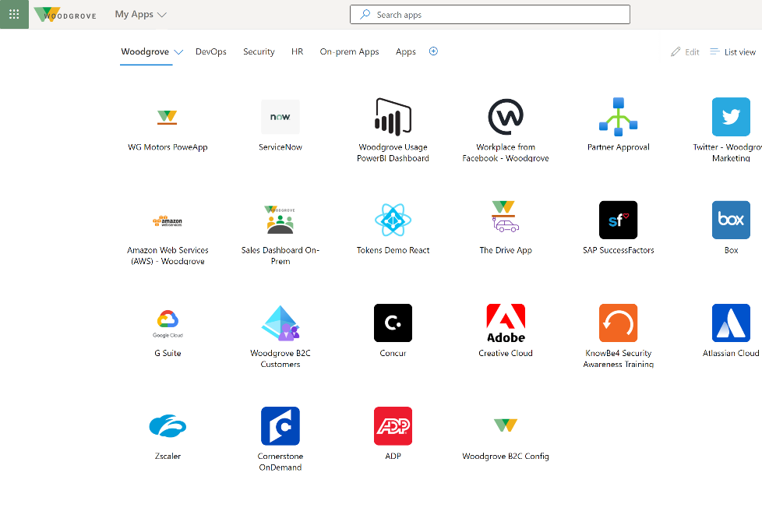
Improve IT efficiency and free up focus
Reduce overall IAM management effort by 50% by consolidating identity management
Simplify identity management Get a complete IAM solution to manage authentication, authorization, external identities, governance, and more.
Streamline operations Free up IT resources to focus on strategic projects rather than maintaining costly on-premises infrastructure.
Reliable and resilient system Ensure business continuity with 99.99% uptime for Azure AD user authentication.
Notes:
Simplify your identity management with Azure AD’s complete IAM solution, with built-in capabilities to manage authentication, authorization, external identities, identity governance, and more.
With your organization’s identity management consolidated in the cloud, you can free up more IT resources to focus on strategic projects rather than maintaining costly on-premises infrastructure.
Microsoft is committed to the resilience and availability of Azure AD, including Public service level agreement (SLA) to promise 99.99% uptime for Azure AD user authentication.

Slide 13




Remove before presenting: For customers unable to fully migrate to Azure AD and still require on-premises Active Directory, present this slide to encourage customers to use Microsoft Defender for Identity to protect their on-premises identities.
Microsoft Defender for Identity for on-premises identity protection
Microsoft Defender for Identity helps security operations teams protect user identity as part of on-premises and cloud enterprise environments
Prevent
Detect
Investigate
Respond
Proactive identity security posture assessments
Real-time analytics and data intelligence
User investigation priority
Automatic response to compromised identities
Cloud scale, continuous updates
Notes:
For customers who are unable to fully migrate off on-premises AD and require AD, pitch Microsoft Defender for Identity to help protect their AD envionrments.
If you’re not able to migrate off of AD FS, you can still protect your on-premises resources using Microsoft Defender for Identity.
Prevent > Proactive Identity Security Posture Assessments
Microsoft Defender for Identity assessments enable SecOps to proactively identify and correct hidden vulnerabilities—thereby reducing the attack surface.
Detect > Real Time Analytics and Data Intelligence
Defender for Identity network-traffic analytics and data intelligence enable SecOps to detect issues through high-confidence alert signals and user behavior anomaly signals in real time.
Investigate > User Investigation Priority
Microsoft Defender for Identityuser investigation priority scoring helps SecOps identify, understand, and prioritize investigations of an organization's riskiest users.
Respond > Automatic Response to Compromised Identities
Defender for Identity helps SecOps reduce response time through user risk policy management and through Microsoft 365 Defender’s advanced hunting functionality. Threat hunters can create their own custom alerts from advanced hunting queries, which can tie information together from across identities, endpoints, email and apps.

Slide 14
How to approach your AD FS migration
Key actions to start any
AD FS to Azure AD migration
Key actions to start migrating apps from AD FS to Azure AD
Key actions to start migrating from federation to cloud authentication
Install Azure AD Connect to enable hybrid identity capabilities
Use the AD FS application activity report to discover, classify, and prioritize apps on AD FS to migrate
Determine which cloud authentication method, password hash sync (PHS) or passthrough authentication (PTA) is most appropriate
Install Azure AD Connect Health to assess your current AD FS environment
Migrate SaaS apps using prebuilt integrations available in the Azure AD app gallery
Migrate to cloud authentication using staged rollout to test select groups of users with cloud authentication capabilities
Ensure any new apps are onboarded and connected to Azure AD
Migrate on-premises and legacy apps using App Proxy or with a secure hybrid access partner
Notes:
Now that we’ve gone over some of the key features and functionality of Azure AD, let’s talk about getting started on your migration journey.

Slide 15
Next steps
1
2
3
Asses your existing AD FS estate by installing Azure AD Connect Health
Request a Securing Identities Workshop
Accelerate your journey with free AD FS migration support with FastTrack
Notes:
We’ve given you a good overview on how to get started, but I wanted to highlight some simple next steps you can take towards migrating and connecting all your apps to Azure AD.
Five simple steps you can take:
Make sure all new apps are secured by Azure AD. Stop accruing debt. New apps connect them to Azure AD.
Determine which existing apps to migrate first – starting with the most used apps.
Integrate apps that rely on other identity providers. During your discovery process, you may find applications that use alternative identity solutions, including AD FS or other identity providers. Consider how you can consolidate these apps to Azure AD to save money and increase security.
Next, start to move your on-premises and legacy apps to Azure AD
And finally, get your developers on board to build apps that integrate with Azure AD and use modern authentication protocols.
To learn more about these steps, visit: aka.ms/fivestepappintegration

Slide 16

Resources
Webpage: Upgrade from AD FS to Azure AD | Microsoft Security
Technical Resources
Migration Resources: Migrate apps and authentication to Azure AD | Microsoft Docs
Application Migration: Moving applications from AD FS to Azure AD | Microsoft Docs
Cloud Authentication: Choosing the right cloud authentication method | Microsoft Docs
Video Walkthroughs: Move apps and authentication from AD FS to Azure AD
Notes:
To wrap up, it’s become clear how valuable a single identity solution can be in securing and centralizing your identity and app management efforts, particularly for an increasingly remote workforce. By moving all your apps to Azure AD, IT teams can benefit from peace of mind knowing that every application is accessible and manageable from a single, secure solution.
It’s more important than ever for IT teams to see how streamlined the migration process can be, and how valuable it is to have applications centralized on a single, secure solution like Azure AD.
For additional resources on securing and managing all apps with Azure AD, visit these essential resources: we offer migration guidance, tools, demos and video tutorials to help you get started.
------
YouTube Videos:
Add an OpenID Connect app to your tenant from the application gallery - Azure Active Directory – YouTube
How to troubleshoot SAML SSO with Azure Active Directory – YouTube
My Apps: Overview | Azure Active Directory – YouTube
My Apps: Deployment | Azure Active Directory – YouTube
My Apps: Collections | Azure Active Directory – YouTube
Overview of migrating apps and authentication to the cloud | Azure Active Directory – YouTube
How to use AD FS activity report to migrate an application | Azure Active Directory – YouTube
Moving legacy authentication to the cloud | Azure Active Directory – YouTube
How to integrate applications with Azure Active Directory – YouTube
Take your apps to the next level with provisioning from Azure Active Directory – YouTube
How to roll out single sign on for SaaS applications | Azure Active Directory – YouTube
How to deploy single sign on for SaaS applications | Azure Active Directory – YouTube
What's single sign on for SaaS applications? | Azure Active Directory – YouTube
What is Application Proxy in Azure Active Directory? – YouTube
How to deploy Application Proxy in Azure Active Directory – YouTube
How to roll out Application Proxy in Azure Active Directory – YouTube
App Migration Whitepaper – https://aka.ms/migrateapps/whitepaper
App Migration Toolkit – https://aka.ms/MigrateApps
General migration guidance
AD FS to Azure AD readiness tool
Deployment plans
Solution guides
Video Guidance:
Overview of Moving Apps and Authentication to the Cloud: https://youtu.be/hlfoRvdaRIY
Move Apps from AD FS to Azure AD: https://www.youtube.com/watch?v=OThlTA239lU
Moving Legacy Applications to the Cloud: https://www.youtube.com/watch?v=CjcrFAkcYLU
Microsoft identity platform: https://aka.ms/identityplatform
InTune App Protection SDKs: https://aka.ms/IntuneAppSDK

Slide 17
Thank you

Slide 19

Tools to help you upgrade from AD FS to Azure AD
Notes:
Let’s get into some of the tools that will help you migrate.

Slide 20
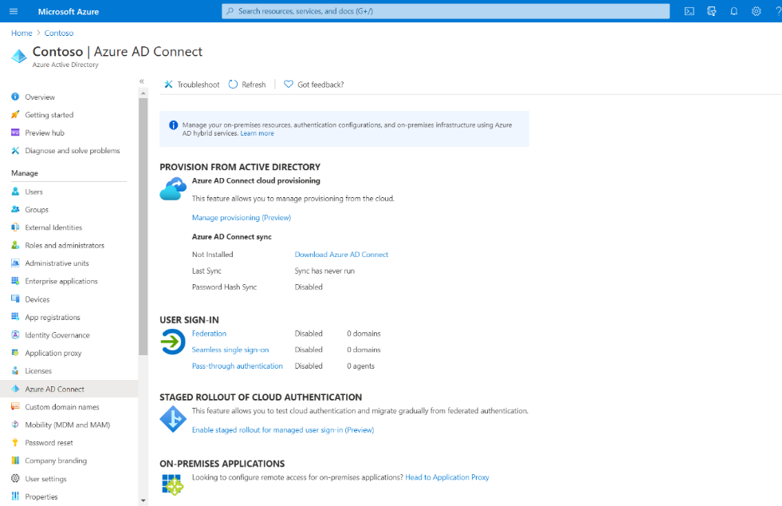
Azure AD Connect
Designed to meet your hybrid identity goals by connecting your on-premises identity infrastructure to Azure AD
Use a single identity to access resources from on-premises applications to cloud apps like Microsoft 365
Single tool to provide an easy deployment experience for synchronization and sign-in
Notes:
Azure AD Connect is the Microsoft tool designed to meet and accomplish your hybrid identity goals. It provides the following features:
Password hash synchronization - A sign-in method that synchronizes a hash of a users on-premises AD password with Azure AD.
Pass-through authentication - A sign-in method that allows users to use the same password on-premises and in the cloud, but doesn't require the additional infrastructure of a federated environment.
Federation integration - Federation is an optional part of Azure AD Connect and can be used to configure a hybrid environment using an on-premises AD FS infrastructure. It also provides AD FS management capabilities such as certificate renewal and additional AD FS server deployments.
Synchronization - Responsible for creating users, groups, and other objects. As well as, making sure identity information for your on-premises users and groups is matching the cloud. This synchronization also includes password hashes.
Health Monitoring - Azure AD Connect Health can provide robust monitoring and provide a central location in the Azure portal to view this activity.

Slide 21
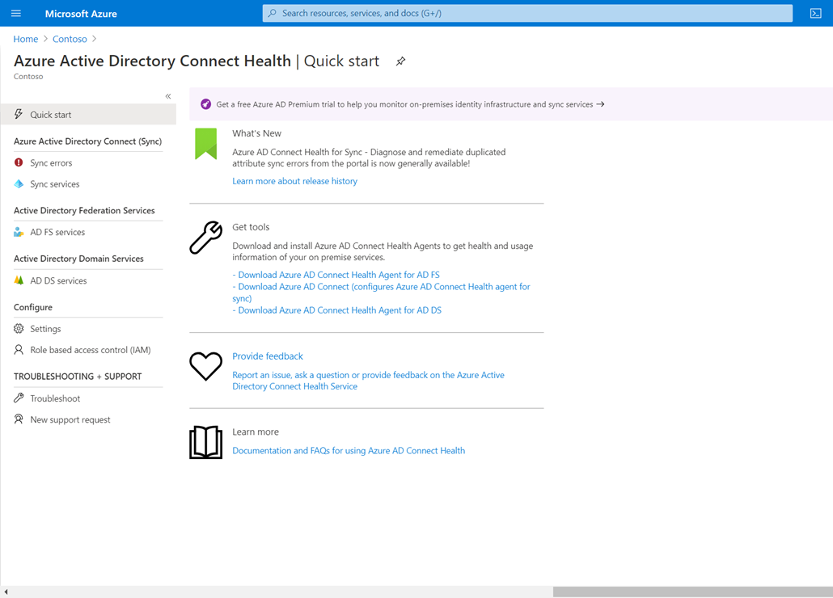
Azure AD Connect Health
Monitor and gain insights into your on-premises identity infrastructure
View alerts, performance monitoring, usage analytics, and other information in the Azure AD Connect Health portal
Easy to deploy and manage agent installed on your AD FS and Proxy servers
Resources
aka.ms/aad-ch
Notes:
We touched on Azure AD Connect Health briefly. Azure AD Connect Health can provide robust monitoring, and acts as a central location in the Azure portal to view this activity.

Slide 22
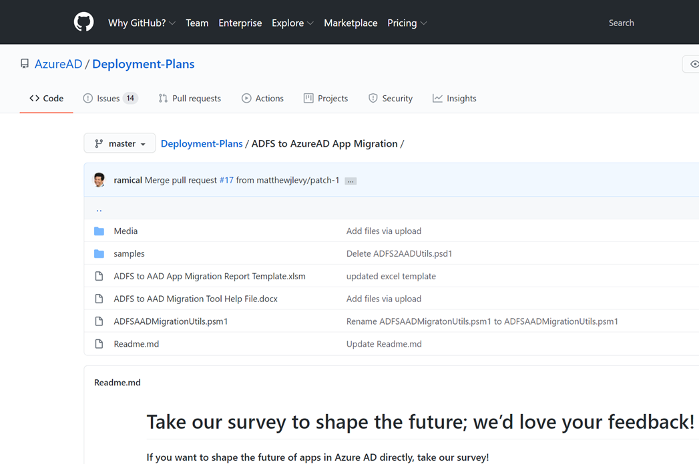
AD FS Application Migration PowerShell Script
Collects the relying party applications from your AD FS server
Analyzes the configuration settings for each application
Get an Excel report of your relying party applications that outlines which applications can be migrated to Azure AD and which ones can’t and why they can’t
Use a script to migrate an AD FS app to Azure AD using the AD FS configuration
Resources
https://aka.ms/migrateapps/ADFStools
https://aka.ms/migrateapps/samples
Notes:
If you don’t have Azure AD Connect installed, you can leverage our AD FS app migration powershell script too.
This is a script you can run on your on-premises Active Directory Federation Services (AD FS) server to determine the readiness of apps for migration to Azure AD.
The AD FS to AAD App Migration tool consists of three steps:
Collect: First, we collect the relying party applications from your AD FS server. This is done via a PowerShell module that will need to run on one of your AD FS server and it writes the configuration of each application to the file system as individual .XML files
Analyze: Next, our PowerShell module will enumerate through the individual .XML files and check the configuration of various settings. This analysis can be done directly on your AD FS server or can be done on another AD FS server but currently, it requires AD FS be installed to properly process the configuration.
Report: Lastly, we generate a final Excel report of your relying party applications that outlines which applications can be migrated to Azure AD and which ones can’t and why they can’t. This part has to be run from a workstation or server where Excel is installed.

Slide 23
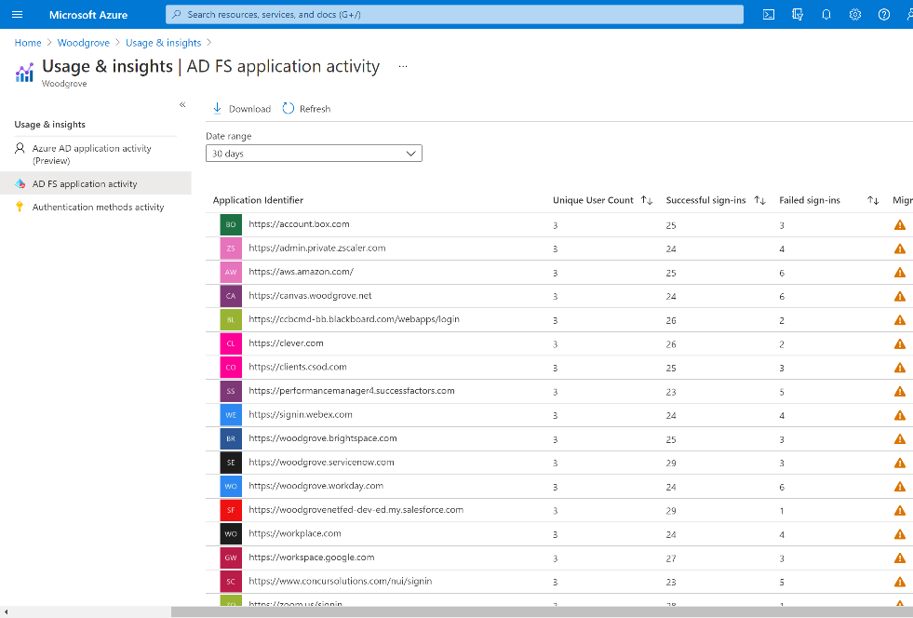
AD FS Application Activity Report
Discover all the AD FS applications in your organization and their readiness for migration to Azure AD
Prioritize applications for migration by seeing the number of unique users who have signed-in to the application
Run migration tests to determine if an application is ready to migrate. View potential migration issues and receive guidance on how to correct
Resources
aka.ms/migrateapps/ADFSactivity
Notes:
The AD FS application activity report (preview) in the Azure portal lets you quickly identify which of your applications are capable of being migrated to Azure AD. It assesses all AD FS applications for compatibility with Azure AD, checks for any issues, and gives guidance on preparing individual applications for migration. With the AD FS application activity report, you can:
Discover AD FS applications and scope your migration. The AD FS application activity report lists all the AD FS applications in your organization and indicates their readiness for migration to Azure AD.
Prioritize applications for migration. Get the number of unique users who have signed in to the application in the past 1, 7, or 30 days to help determine the criticality or risk of migrating the application.
Run migration tests and fix issues. The reporting service automatically runs tests to determine if an application is ready to migrate. The results are displayed in the AD FS application activity report as a migration status. If potential migration issues are identified, you get specific guidance on how to address the issues.
The AD FS application activity data is available to users who are assigned any of these admin roles: global administrator, report reader, security reader, application administrator, or cloud application administrator.
Prerequisites
Your organization must be currently using AD FS to access applications.
Azure AD Connect Health must be enabled in your Azure AD tenant.
The Azure AD Connect Health for AD FS agent must be installed.
Learn more about Azure AD Connect Health
Get started with setting up Azure AD Connect Health and install the AD FS agent

Slide 24



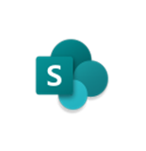

AD FS to Password Hash Sync
Modern authentication approach and requires no additional on-premises infrastructure outside of your existing AD stores and credentials
Hashes of user passwords are synchronized from on-premises Active Directory to Azure AD, allowing Azure AD to authenticate users without interacting with the on-premises Active Directory
Microsoft Azure AD
Office 365, SaaS, and LoB apps
Password Hash synchronization
On-premises
Resources
Deployment guide https://aka.ms/ADFSToPHSDPDownload
Notes:
Password Hash Sync. In this method, a hash value of the user’s password is extracted and synchronized in Azure AD to authenticate the user when they sign in from the cloud. They can use the same username and password from the on-premises environment to access cloud resources too. This helps IT because they don’t have to deploy any additional infrastructure to make it work in the cloud. This method also enables Azure AD Identity Protection capabilities, which protect and monitor your users’ passwords against leaked credential reports to prevent bad passwords from being used.

Slide 25
AD FS to Pass Through Authentication
An authentication agent must be installed on-premises along with existing AD infrastructure
Password validation requests are sent to the agent and passed through to AD to verify credentials and enable user authentication in Azure AD
Microsoft Azure AD
Office 365, SaaS, and LoB apps
Pass-through authentication
On-premises
Pass-through authentication agent
Resources
Deployment guide: https://aka.ms/ADFSTOPTADPDownload
Notes:
The second one is Pass-through Authentication. This method uses a software agent to connect to passwords stored on-premises for validation, so that users can sign in to cloud apps with the same username and password for on-premises resources. It’s a lightweight solution for IT and does not store any form of user passwords in the cloud, which may be a requirement for certain organizations. Like Password Hash Sync, pass-through authentication protects your on-premises accounts by working seamlessly with Azure AD conditional access policies, and it also supports Smart Lockout to prevent brute force attacks.
I’ve covered cloud authentication methods, but there’s another option for custom or complex authentication needs, called federated authentication.
With Federated Authentication, Azure AD will hand off the authentication process to a separate trusted authentication system, such as Active Directory Federation Services, to validate the user’s password or sign-in. This method makes sense for organizations with authentication requirements not currently available in Azure AD, such as legacy application protocols.

Slide 26
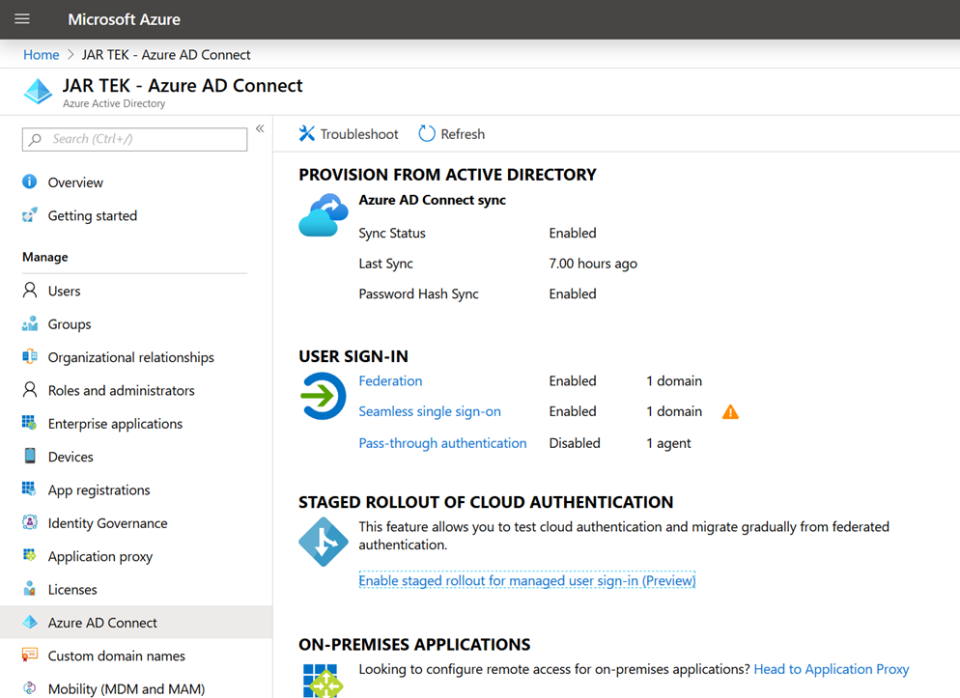
Staged roll-out to Cloud Authentication
Migrate your users’ authentication from federation to cloud authentication in a staged and controlled manner
Selectively test groups of users with cloud authentication capabilities like Azure AD Multi-Factor Authentication (MFA), Conditional Access, Identity Protection and others
Resources
Public Blog Post
Ignite Session
Notes:
Azure AD Staged rollout to cloud authentication in Public Preview
This feature allows you to migrate your users’ authentication from federation—via AD FS, Ping Federate, Okta, or any other federation on-premises system—to cloud authentication in a staged and controlled manner.
Public Blog: https://techcommunity.microsoft.com/t5/Azure-Active-Directory-Identity/Staged-rollout-to-cloud-authentication-now-in-public-preview/ba-p/827830
Ignite session: https://myignite.techcommunity.microsoft.com/sessions/81739?source=sessions

Slide 27
Engineered for availability and security
Cloud-native, hyper-scale, multi-tenant architecture
Over 100 datacenters across the planet
Each physical datacenter protected with world-class, multi-layered protection, and engineered for maximum availability
Secured with cutting-edge operational security
Restricted access
24x7 monitoring
Global security experts
Global cloud infrastructure with secure hardware and data segregation
Notes:
https://techcommunity.microsoft.com/t5/azure-active-directory-identity/99-99-uptime-for-azure-active-directory/ba-p/1999628
Talk Track:
Service reliability and availability is one of the top considerations for our customers in choosing an Identity and Access Management solution.
With Azure AD being the largest enterprise cloud identity service, reliability and security of our service is a top priority for Microsoft.
It starts with operational excellence in the cloud (clock-wise on the globe)
Physical security
Operational security
Global cloud fabric that runs our clouds (Office365, Azure) and our security services
The first side is the secure foundation of our cloud services. This is about how we operate our own cloud services, Azure, Office 365 and so forth. We have some of the world's best physical security, with fences and barbed wire and so on to provide secured building environments and within those buildings, secure server environments.
Providing maximum availability, we design and distribute our physical datacenters to be highly redundant, so that there are no single points of failure. We look for multiple levels of isolation, ways to elastically scale, and fine grained, physically separate domains to minimize risk while also offering decorrelated backup authentication services.
To enter a server environment, for example, a person would have to pass through multiple physical layers and provide multiple forms of identification. They would also be scanned for metal in their pockets to make sure that they are not bringing devices in to steal information. So, there's a great deal of physical security in place that we do on behalf of all of our customers in our cloud services and that make it possible for our customers to really leverage the investment that we've made in that respect.
Operational security I touched on a minute ago when we talked about the human piece of the Intelligent Security Graph. One of the ways this comes to life is in our continual testing of our services, making sure that that we're finding vulnerabilities faster than the bad guys can. We have a big focus on red team, blue team exercises. If you're not familiar with those, the idea is that we have dedicated professionals whose job it is to be on the good side but act like the bad guys—they’re constantly trying to find ways to penetrate the services, find ways that hackers might attack us so that we can shore up our defenses.
Another example of our operational excellence is around restricted access. When Microsoft employees need elevated access so that they can do maintenance on a service, or so they can investigate a customer support issue, they only have access to exactly the resources they need to access and for only exactly the amount of time that they need it. So, they have just in time and just enough access to do their work, and then they get out. They don't have any standing elevated access that allows them to view customer data.
And this is something, again, where we can make an investment at Microsoft that gets heavily leveraged because all of our customers benefit.
Lastly, customer controls are a huge important part of this. This is something that we get asked about a lot when we talk to customers about our cloud services. What are the things that I have at my control so that I can decide how I want to manage my data and access to it? Access controls, of course, are the very foundation of it. Multi-factor authentication for admins at customer sites who are in charge of operating Azure for that customer or operating Office 365. Having multi-factor authentication of course is a basic that we think is fundamental.
And lastly, network and distributed denial of service protection is in place for all of these services. We do basic protection to ensure our services work reliably, and Azure customers can take advantage of additional protection at the network layer to suit their needs.

Slide 28
AD FS Capabilities in Azure AD
AD FS capability
Azure AD capability
SSO
SSO
Alternate ID
Alternate ID
OATH Hard Tokens
OATH Hard Tokens
3rd party MFA provider
Custom Controls and Conditional Access Extensibility
Block Legacy Authentication
Block Legacy Auth with Conditional Access
Customer managed on-premises servers
Microsoft managed infrastructure with 99.99% uptime
User Certificate Based Authentication
Attribute claims from external sources
User Certificate Based Authentication
Identity protection
Identity governance
Application provisioning
Brute force and DDOS mitigation
Mitigate on-premises outages
Conditional Access
…and more
Notes:
https://techcommunity.microsoft.com/t5/azure-active-directory-identity/protecting-microsoft-365-from-on-premises-attacks/ba-p/1751754

Slide 29
AD FS to Azure AD roadmap
Capability | Current status | Expected
Support for additional claims, claims transformations and SAML configuration settings | Private Preview | H1 FY22 Public Preview
Sign-in using smartcards or certificate-based authentication | Private Preview | H2 FY22 Public Preview
Attribute claims from external repositories and user stores | In development | H1 FY22 Public Preview
Use of nested groups for coarse-grained authorization | In development | TBD
Sign-in using third-party authentication solution, including on-premises MFA server | In development | TBD
Requirement for authentication and authorization for critical locally-hosted apps not reliant on internet connectivity | In development | TBD
Enforcing per-app authentication types | In development | TBD
Air-gapped environments | In development | TBD

